Slide 1
Top Down View
North
10.24
BNC
Buffer space for BNC
6.1
1.5
~0.5
USB Board
2.5
S
S
Buffer space for wires
3.9
USB
7.09
West
4.8
P
East
Isolation Board
S
S
S
S
2.5
S
Ribbon
S
P
USB
2.36
SAMTEC
1
South
All dimensions are in inches. Not drawn to scale!
1.8
mid-line

Slide 2
Side View
Electronics Facing Up
Isolation Board
Electronics Facing Up
USB Board

Slide 3
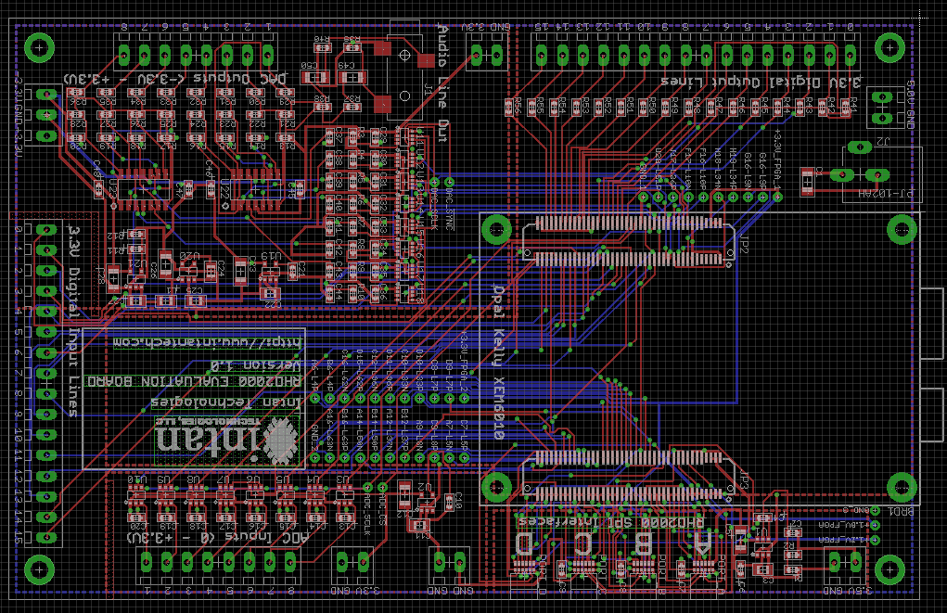
USB Board
Screw Hole Lengths from Center to Edge
Corner | Delta X | Delta Y
NW | 200 | 200
NE | 200 | 200
SE | 200 | 200
SW | 200 | 200
USB
P

Slide 4
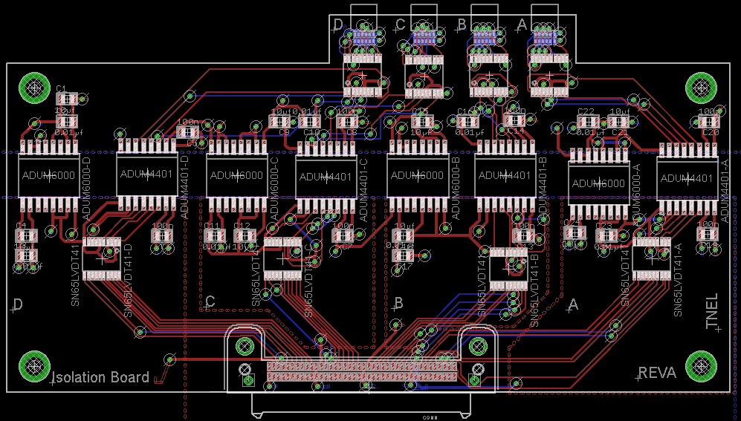
Isolation Board
Screw Hole Lengths from Center to Edge
Corner | Delta X | Delta Y
NW | 180(4) | 166(4)
NE | 195(4) | 166(4)
SE | 195(4) | 175(4)
SW | 180(4) | 175(4)
Have isolation board facing down (electronics facing down)
Note: All lengths are reported in mils (thousandth of an inch), with uncertainty in (.)

Slide 5
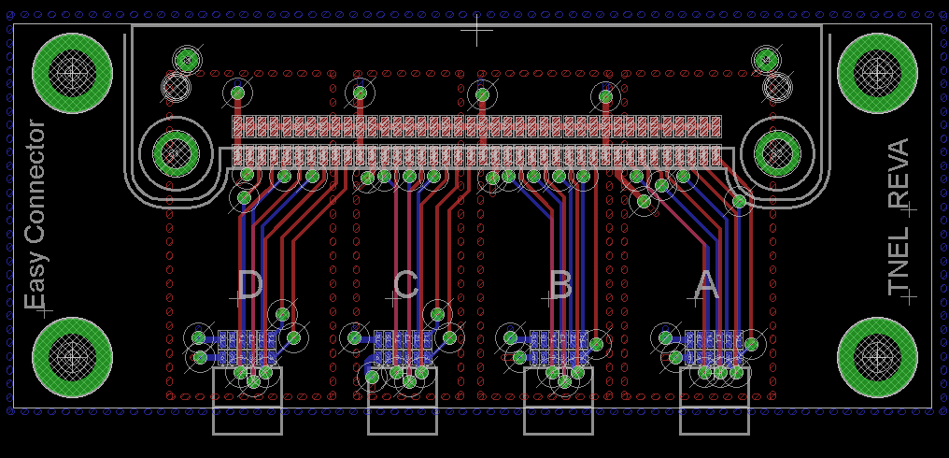
Easy Connector
Screw Hole Lengths from Center to Edge
Corner | Delta X | Delta Y
NW | 150 | 127(1)
NE | 139(1) | 127(1)
SE | 139(1) | 130
SW | 150 | 130

Slide 6
Capture Box 3D
South Panel View
P
USB
Ribbon Cable Slit
North Panel View

Slide 7
Easy Connector 3D
SAMTEC
Ribbon Cable

Slide 8
Part References/Specs
USB Board
http://www.intantech.com/RHD2000_USB_interface_board.html
Isolation Board
https://www.dropbox.com/sh/rtxgdsem57ctndv/AAA75mkSLeLykQKeLrcl0iwBa
Easy Board
https://www.dropbox.com/sh/qj834wxvz5nfjsx/AAAAEEapNii0fB531sr1DuTGa
Samtec Male Connector (on Isolation Board)
ERM8-040-01-L-D-RA-TR
http://www.samtec.com/technical-specifications/Default.aspx?seriesmaster=ERM8-RA
Samtec Female Connector (on Easy Board)
ERF8-040-01-S-D-RA-TR
http://www.samtec.com/technical-specifications/Default.aspx?SeriesMaster=ERF8-RA
Samtec Ribbon Cable
ERCD-010-05.00-SBR-TED-1-D
https://www.samtec.com/technical-specifications/Default.aspx?seriesmaster=ERCD
http://www.samtec.com/documents/webfiles/cpdf/ERCD-XXX-XX.XX-XXX-XXX-X-X-MKT.pdf
Omnetics Connector (on USB Board, Isolation Board and Easy Board)
A79623-001
http://www.omnetics.com/polarized-nano/cots/

Slide 9
Isolation Board, CPL
RefDes,Layer,LocationX,LocationY,Rotation
ADUM4401-A,Top,4.540,1.770,180
ADUM4401-B,Top,3.330,1.790,180
ADUM4401-C,Top,2.140,1.780,180
ADUM4401-D,Top,0.950,1.800,180
ADUM6000-A,Top,3.950,1.740,180
ADUM6000-B,Top,2.750,1.790,180
ADUM6000-C,Top,1.550,1.790,180
ADUM6000-D,Top,0.300,1.790,180
C1,Top,0.420,2.300,0
C2,Top,0.420,2.150,0
C3,Top,0.150,1.260,0
C4,Top,0.150,1.390,0
C5,Top,1.220,2.080,180
C6,Top,1.050,1.390,180
C7,Top,2.250,1.390,180
C8,Top,2.280,2.150,180
C9,Top,1.830,2.150,180
C10,Top,2.030,2.150,180
C11,Top,1.400,1.390,0
C12,Top,1.600,1.390,0
C13,Top,3.450,1.390,180
C14,Top,3.390,2.160,180
C15,Top,2.780,2.150,0
C16,Top,3.080,2.150,0
C17,Top,2.650,1.260,180
C18,Top,2.650,1.390,180
C19,Top,4.670,1.400,180
C20,Top,4.680,2.150,180
C21,Top,4.080,2.150,180
C22,Top,3.880,2.150,0
C23,Top,4.000,1.390,0
C24,Top,3.790,1.410,0
CONN,Top,2.420,0.380,180
OMNETICS-CONNECTOR-SLAVE-A,Bottom,3.591,2.770,0
OMNETICS-CONNECTOR-SLAVE-B,Bottom,3.191,2.770,0
OMNETICS-CONNECTOR-SLAVE-C,Bottom,2.791,2.770,0
OMNETICS-CONNECTOR-SLAVE-D,Bottom,2.391,2.770,0
SN65LVDT14-A,Top,3.620,2.460,0
SN65LVDT14-B,Top,3.220,2.460,0
SN65LVDT14-C,Top,2.790,2.450,0
SN65LVDT14-D,Top,2.380,2.460,0
SN65LVDT41-A,Top,4.300,1.240,180
SN65LVDT41-B,Top,3.350,1.170,180
SN65LVDT41-C,Top,1.850,1.240,180
SN65LVDT41-D,Top,0.650,1.240,180

Slide 10
Easy Board, CPL
OMNETICS-MASTER-FPGA-A,Bottom,0.600,0.630,180
OMNETICS-MASTER-FPGA-B,Bottom,1.000,0.630,180
OMNETICS-MASTER-FPGA-C,Bottom,1.400,0.630,180
OMNETICS-MASTER-FPGA-D,Bottom,1.800,0.630,180
U$1,Top,1.190,1.510,0 ← “CONN”

